Slide 1

Application: ToGo Type: Application Architecture View: Logical View Style: Layered Architecture Pattern
Users
Deliver Channels
Core Business Processes
Data And Information
Technology Enablers
User Account
User’s Personal
Messaging Bus
Mobile App
Customers
Real-time Bus
Home
Order Data
Internet
E-Payment
Delivery Cart
Transactions
Employees
Email
Web Services
Help Desk
Payment Information
B2B-getaway
Suppliers

Slide 2
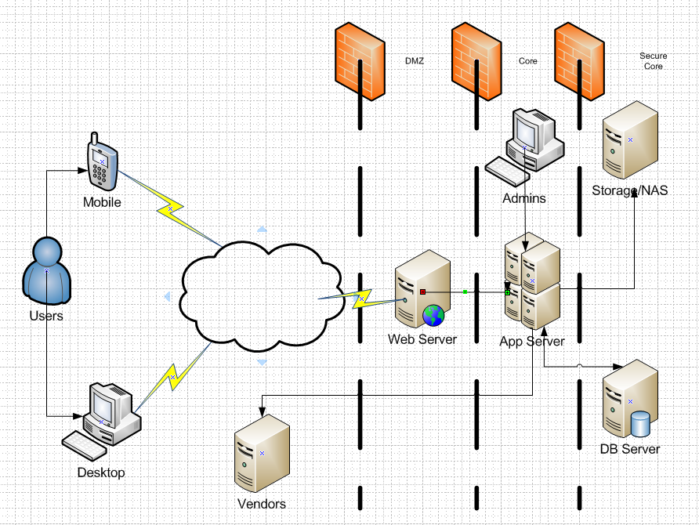
Application: ToGo Type: Application Architecture View: Process View Style: Client-Server Pattern

Slide 3
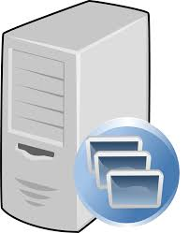
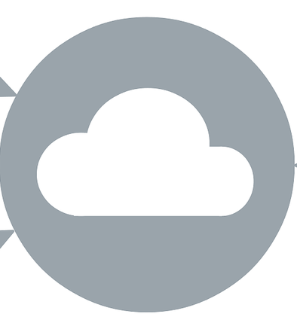
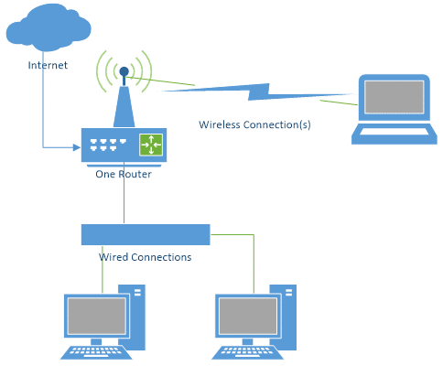
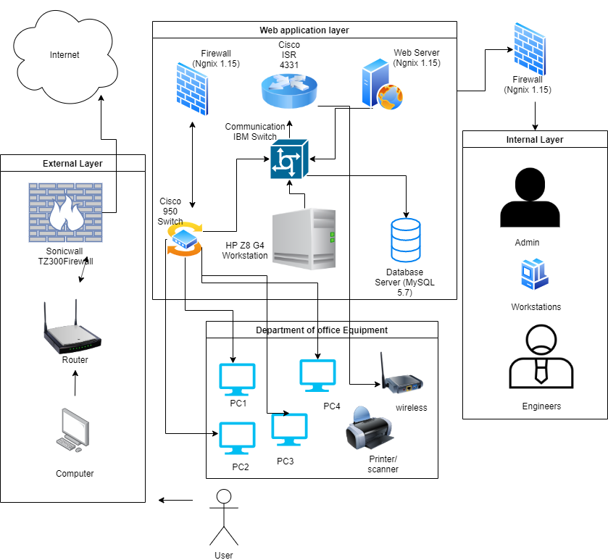

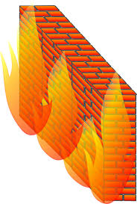

Application : ToGo Type : Application Architecture View : Physical View Style : Layered Architecture Pattern
a
Web Application Layer
Firebase Cloud
Internal Layer
Application Server
Router
Internet
Admin
External Layer
Cisco ASA 5505X
Computer
Office Equipment
Web Server
Access Point
PC4
Printer/Scanner

